Slide 1
Introduction
In appendix 2, you’ll find a list of the terms and acronyms used in this presentation.
Concerning the documents referred to in this presentation:
  Unless otherwise stated, you can download the documents from www.houmollerconsulting.dk/facts-findings/.
This PowerPoint presentation is animated
  It’s recommended to run the animation when viewing the presentation.
On most computers, you can start the animation by pressing F5.
  Now the presentation moves one step forward, when you press Page Down. It moves one step backward, when you press Page Up.

Slide 2
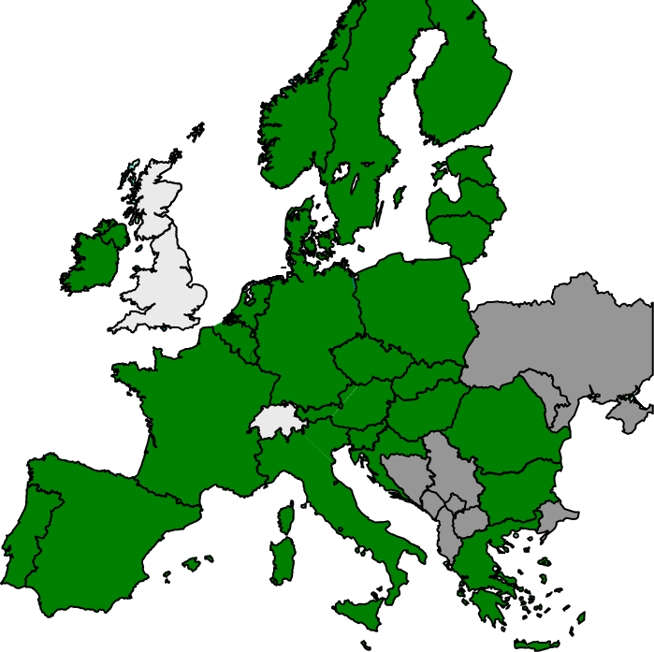
Market coupling in Europe
The current market coupling encompasses the map’s green area.
Hopefully, the dark grey areas will join within
the foreseeable future.
However, we need to improve the market
coupling’s governance & operation.
This is needed anyway
However, it’s urgent as more countries,
more TSOs and more power exchanges
join the market coupling.
And as we implement the green transition.
We need:
Fair competition among the power exchanges.
A neutral and service-minded Market Coupling Operator (MCO).
Transparency of the system, which yearly distributes dozens of billions of euro between countries and market players.
Democratic control and fair influence for the stakeholders.
Efficient market surveillance.

Slide 3
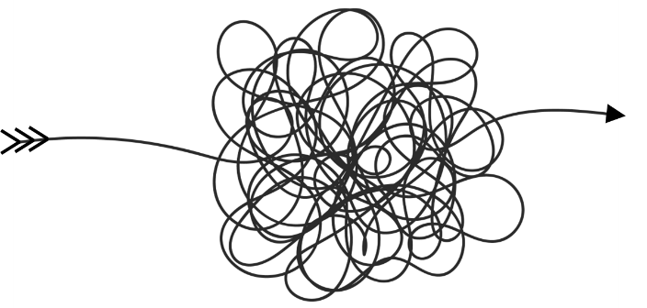


The current market coupling
The current market coupling has serious flaws.
It requires unnecessarily high amount of human
and financial resources
For example: many power exchanges making the same daily calculation of spot prices and market coupling flows – using same input and same software.
The daily market coupling operation is
too complex and risky
Far too many cooks to spoil the broth.
This has repeatedly led to crashes of
Europe’s market coupling
Very expensive for both consumers
and players at the whole-sale market.
An error at just one of the many cooks
causes uncoupling of Europe.

Slide 4

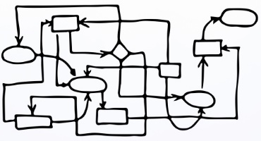
Current market coupling: flaws – 1
Grid users have been forced to pay for the market coupling software EUPHEMIA
Nevertheless, some of the NEMOs claim ownership
to EUPHEMIA – and the source code is kept secret.
Considering the financing of EUPHEMIA and the
monopoly status of EUPHEMIA, this seems strange.
Further, it’s distorting the competition between NEMOs
Market coupling algorithms’ ownership hinders
level playing field, transparency and innovation.
Competitive NEMOs’ conflicts of interest
obstruct cooperation for market coupling.
The market coupling’s convoluted organization
& operation makes it difficult to establish
efficient regulatory oversight and cost regulation
Not necessarily inconvenient for the NEMOs claiming ownership of the market coupling software.

Slide 5
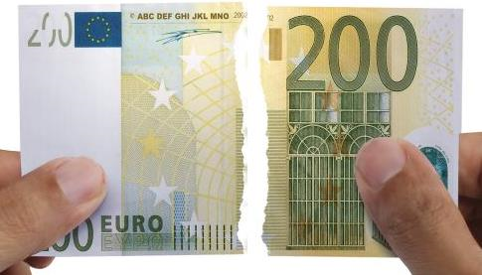
Current market coupling: flaws – 2
Slow, complex and delayed implementation of changes. This has affected improvements
necessitated by the green transition
For example: endless delays in the implementing
of a shift to 15-minutes trading across Europe.
In some cases, active NEMO resistance against
changes, which will further the green transition
*)
For example, NEMO resistance against nodal pricing.
NEMO-invented specifications for the EUPHEMIA software, which were not requested by consumers (who are paying
for the whole circus). For example:
A preference for small block bids
at the expense of bigger block bids.
A requirement that neighbouring bidding zones must have the same spot prices, if the interconnector connecting the two zones is not fully utilized.
Such unrequested, extra requirements may have reduced the value created by the European spot trading with 40%.
*) See the PowerPoint presentation Nodal and zonal pricing

Slide 6



A single, neutral, service-minded Market Coupling Operator (MCO)
The MCO must be neutral in all respects.
For example: it’s not the task of the MCO to
have opinions on how the spot market should be organized.
A service-minded MCO has the task of implementing what electricity consumers, electricity producers and other qualified stakeholders specify – without delay.
We need a well-regulated, cost-efficient single MCO for the Single Electricity Market.
For more information, please see the
PowerPoint presentation Unbundling
and EU’s Single Electricity Market.
And see ACER’s paper Initial impact assessment on the market coupling organisation (search ACER’s home page).

Slide 7


By way of comparison: the balancing platforms
To maintain the security of supply, the European TSOs buy the so-called ancillary services.
  The TSOs buy different types of ancillary services.
  The services are bought at the balancing markets.
For each type of ancillary service, we’ll have a single platform with a single operator
  We’ll not have anything similar to the market coupling system, which has the flaws outlined previously.
For the operation of the market coupling, we just need to establish the same system
  Note: the balancing markets is serious business
    As it concerns the issue of keeping the lights on.
    If we can use this system for the balancing markets,
    we can surely use it for the market coupling also.
copy-paste
No one has in earnest suggested copying the current market coupling system to the balancing markets…

Slide 8
Why Market coupling?
With market coupling, the day-ahead plans for the cross-border
energy flows are calculated using:
The market players’ spot bids
i.e., the prices at which the players are willing to buy
and sell at a spot exchange.
Information on the day-ahead cross-border grid capacity.
Actually, market coupling is a step backwards towards
planned economy.
The truly market-based method:
Allow the market players to do the day-ahead
cross-border trading themselves.
However, experience shows this gives
many hours with energy flows, which are
sub-optimal for society.
Because it’s difficult for individual market
players to make optimal use of the monopoly
transportation system (i.e., the grid).
The monopoly transportation system distinguishes
electrical energy from most other commodities.

Slide 9
The task for market coupling
A perfect bilateral cross-border trading system:
  A system where all players have perfect market oversight
    i.e., all players know the market price.
  No abuse of market power or any other foul play.
Such a perfect bilateral bilateral cross-border trading system would automatically settle into the Pareto optimal state.
The task for the market coupling algorithm:
As far as possible, reproduce the Pareto optimal state, which a perfect bilateral trading system would automatically establish.
€

Slide 10
The algorithm calculating spot prices and market coupling flows
The requirement at the previous slide means the algorithm must sit
at the intersection between market economy and computer science
Computer science:
Mixed-integer
linear optimization
Market economy
Find the Pareto
optimal solution

Slide 11
Targeting the optimal solution
Avoiding value-destroying specifications
Market coupling software – with the perfect, bilateral trading system as the target, avoiding some specifications are obvious:
Do not have
  Preferences for small block bids at the expense of bigger block bids.
  Asymmetrical prices, where the sellers’ price differs from the buyers’ price.
  A requirement that two neighbouring bidding zones must have the same spot price, if their interconnector is uncongested.
  Blocking of counter-intuitive flows, where the flow on some interconnectors goes towards the low price.
The optimal solution does not have these features.
Hence, installing such extra requirements will severely reduce the value created by spot trading.

Slide 12
Transparency
The market coupling software is a monopoly system
  Wich grid users have been forced to finance.
The software daily distributes hundreds of millions of euro between countries and between market players.
Therefore, it must be Open Source Software
  Anyone can access the source code.
  This will enable universities, think tanks and anyone else to check for errors and make in-house tests of amendments
    This means crowdsourcing the tasks of finding errors and testing improvements.
  This is why Open Source Software is safer than software where the code is kept secret.
  By way of comparison: in the Nordic countries, the introduction of flow-based market coupling has been delayed due to errors in the NEMOs’ market simulation tool
    For obvious reasons, running tests must not be based on a secret NEMO monopoly.

Slide 13

Market surveillance – 1
Enforcing the REMIT rules
Naturally, the NEMOs must not have the right to deny ACER or any other regulator access to the spot bids
  Non-anonymised spot bids must be included in ACER’s database of electricity trades.
  However, apart from this, the creation of a single Market Coupling Operator is not associated with the issue of market surveillance.

Slide 14


Market surveillance – 2
Enforcing the REMIT rules
EU’s REMIT rules provide an excellent legal framework for EU’s whole-sale electricity and gas markets
  However, we need to enforce the rules.
Every day, for the whole-sale electricity and gas markets, ACER col­lects more than 7.2 million records of transactions
  According to ACER’s recent REMIT Quarterly.
Obviously, manual surveillance is futile.
We need intelligent software trawling this sea of data
  Searching for suspicious patterns.

Slide 15

Market surveillance – 3
Enforcing REMIT rules using artificial intelligence
The software must surveil across all countries and across all markets
  Example: an evildoer could manipulate the spot market
    Afterwards harvesting an ill-gotten gain at the financial market.
Per definition, neither national regulators nor exchanges can carry out this multinational, multi-market task
  Further, we should have only one European organization installing & maintaining such advanced, expensive software.
This leaves us with ACER as the organization carrying out this task
  Conclusion: to provide enforcement of the REMIT rules, ACER’s budget & staff must be significantly increased.

Slide 16

Appendix 1
Getting close to the optimal solution

Slide 17
The optimal solution – 1
Three proposals for improved emulating of the perfect bilateral trading system
Block bids It is necessary to allow market players to send block bids to the spot exchanges
  As thermal producers need this bid form.
However, the introduction of ever more complicated block bids pushes the market coupling software away from the optimal solution.
We need a neutral organization, which can estimate if existing – and proposed new – bid forms move the solution closer to the optimum
  Or push the solution away from the optimum.
Note: having Open Source Software means this task is also crowdsourced.

Slide 18


The optimal solution – 2
Three proposals for improved emulating of the perfect bilateral trading system
Second auction A bilateral trading
system will adjust immediately,
if the trading produces strange results
Hence, second auctions for the
whole coupled area will provide
a better emulation of the optimal
trading system.
Second chance
Changing the spot price limits We must
have an organized, regulator-approved
way of lowering the spot market’s
price ceiling
Same for changing the price floor.

Slide 19
Appendix 2
Terminology and acronyms

Slide 20
Terminology and acronyms – 1
As used in this presentation
ACER See https://www.acer.europa.eu/en/The_agency/Pages/default.aspx
Ancillary services Services the TSOs are buying to maintain the security of supply. See Wikipedia or see https://www.entsoe.eu/network_codes/eb/
Balancing markets See https://www.entsoe.eu/network_codes/eb/
Bidding zone A geographical area, within which the players can trade electricity day-ahead without considering grid bottlenecks.
Block bids See appendix 1 of the PowerPoint presentation Market coupling – European price coupling.
Border Means a border between two bidding zones.
  Hence, it need not be a border between two countries. It may be a border between two bidding zones inside a country.
Day of Operation The day where the electrical energy is produced and consumed.
Double auction A calculation method whereby an exchange’s price is set by using the exchange’s supply curve and the exchange’s demand curve. See the PowerPoint presentation Maximizing the economic value of market coupling and spot trading and the PDF document The Liberalized Electricity Market.
Electricity Short for electrical energy.
Energy Short for electrical energy.
Energy flow In this document, this is short for “day-ahead plan for cross-border energy flow”.
EUPHEMIA The market coupling software. See https://www.entsoe.eu/network_codes/cacm/implementation/sdac/
Flow Short for energy flow.

Slide 21
Terminology and acronyms – 2
As used in this presentation
Market coupling A day-ahead congestion management system, you can have on a border, where you have spot exchanges at both sides of the border. The day-ahead plans for the cross-border energy flows are calculated using the market players’ spot bids and information on the day-ahead cross-border trading capacity. See the PowerPoint presentation Maximizing the economic value of market coupling and spot trading and the PDF document The Liberalized Electricity Market.
MCO Market Coupling Operator. An organization operating the market coupling.
NEMO Nominated Electricity Market Operator. See https://www.acer.europa.eu/electricity/market-rules/capacity-allocation-and-congestion-management/market-coupling-development
Nodal pricing A market coupling system, where the market decides, which geographical areas that will have the same spot prices.
Nodal pricing contrasts with zonal pricing. With zonal pricing, there are pre-set geographical areas (so-called bidding zones). For each hour and each bidding zone, it has up front been decided, that the whole bidding zone must have the same spot price – irrespective of the state of the market.
For more information, see the PowerPoint presentation Nodal and zonal pricing.
Open Source Software (OSS) This is code that is designed to be publicly accessible. Anyone can see, modify, and distribute the code as they see fit.

Slide 22
Terminology and acronyms – 3
As used in this presentation
Pareto optimum For this presentation, this means a combination of the spot prices, traded spot volumes and market coupling flows with the following quality:
If you change any of the prices, volumes or flows, then the gain this will give some players will be smaller than the loss the change will inflict on other players.
Naturally, this is an obvious definition of an economic optimum.
For more information you may see Wikipedia, for example.
REMIT See https://www.acer.europa.eu/remit/about-remit
Second auction Normally, 12 o’clock the day before the Day of Operation is the deadline for submitting purchase bids and sales offers to the spot exchanges. However, if the calculation of the spot prices yields very high or very low prices, the order books can be re-opened. This gives market players an opportunity to send new spot bids.
Spot bid A purchase bid or a sales offer submitted to a spot exchange.
Spot calculation The simultaneous calculation of spot prices and energy flows. See the PowerPoint presentation Maximizing the economic value of market coupling and spot trading and the PDF document The Liberalized Electricity Market.
Spot exchange In this document, a spot exchange is an electricity exchange where
  Electrical energy is traded day-ahead.
  The exchange’s day-ahead prices are calculated by means of double auction.
  See the PowerPoint presentation Maximizing the economic value of market coupling and spot trading and the PDF document The Liberalized Electricity Market.

Slide 23
Terminology and acronyms – 4
As used in this presentation
Spot price A day-ahead price used by a spot exchange (or the spot exchange’s associated clearing house) to settle the participants’ trading at the exchange.
The spot price is calculated using double auction.
See the PowerPoint presentation Maximizing the economic value of market coupling and spot trading and the PDF document The Liberalized Electricity Market.
TSO Transmission System Operator.
In EU, each TSO has two tasks:
  Operate the high-voltage grid (the transmission grid) in the TSO’s so-called control area.
  Be responsible for the security of supply in the TSO’s control area.
Most EU Member States have only one TSO. Hence, the TSO’s control area is the whole country.
However, some Member States have more than one TSO (e.g. Germany).
Zone Short for bidding zone.

Slide 24

Thank you for your attention!
Anders Plejdrup Houmøller
Houmoller Consulting ApS
Tel. +45 28 11 23 00
anders@houmollerconsulting.dk
Web houmollerconsulting.dk

