Slide 1
Introduction
You’ll find a list of the terms and acronyms used in this presentation in the appendixes.
Concerning the documents referred to in this presentation:
  Unless otherwise stated, you can download the documents from www.houmollerconsulting.dk/facts-findings/.
This PowerPoint presentation is animated
  It’s strongly recommended to run the animation when viewing the presentation.
On most computers, you can start the animation by pressing F5.
  Now the presentation moves one step forward, when you press Page Down. It moves one step backward, when you press Page Up.

Slide 2

Moving towards a renewable energy future
Reforming EU’s day-ahead and intra-day electricity trading
This presentation discusses how
to adapt EU’s day-ahead and
intra-day trading to a world
dominated by renewable energy.
The presentation argues EU must
adapt a version of nodal pricing.
Because the new electricity
business needs
local price signals.
Unless specified, the presentation only discusses trading of
electrical energy
However, the conclusions can also be applied to the TSO’s
markets for capacity.
More information on capacity: see the PowerPoint
presentation Capacity markets and The Single European
Electricity Market.

Slide 3
Reforming EU’s electricity trading
EU’s current day-ahead and intra-day trading allow trades, which the grid cannot sustain.
This forces the TSOs to redispatch inside bidding zones
  This is an expensive solution
    In 2017, the German redispatch costs were € 1.1 billion.
  Further, it means the prices created by the trading do not reflect the value of electricity
    Hence, the day-ahead and intra-day prices are unreliable
      Distorted prices are very costly for society
        Although the size of the losses inflicted by distorted prices are hard to estimate.
*)
*) source https://www.montelnews.com/en/story/europe-risks-costly-mistake-with-redispatch-markets--study/954861

Slide 4

The beginning of a new age
EU’s current day-ahead and intra-day trading systems were devised 20-25 years ago.
Back then, the electricity supply system was dominated by big, central power stations.
The problem: these old trading systems do not fit the modern world.
We are moving towards a more decentralised electricity supply system
Where many small electricity producers feed electricity to the distribution grid
Solar cells and on-shore wind turbines, for example.
Simultaneously, the demand side is changing. For example, due to
Electrical vehicles and prosumers.

Slide 5







The old electricity supply system
electricity producers
Energy flow
Transmission grid
Distribution grid
electricity consumers

Slide 6






The new electricity business
Battery
storage
electricity producers
Energy flow
Transmission grid
Distribution
grid
…
electricity producers, consumers and prosumers

Slide 7
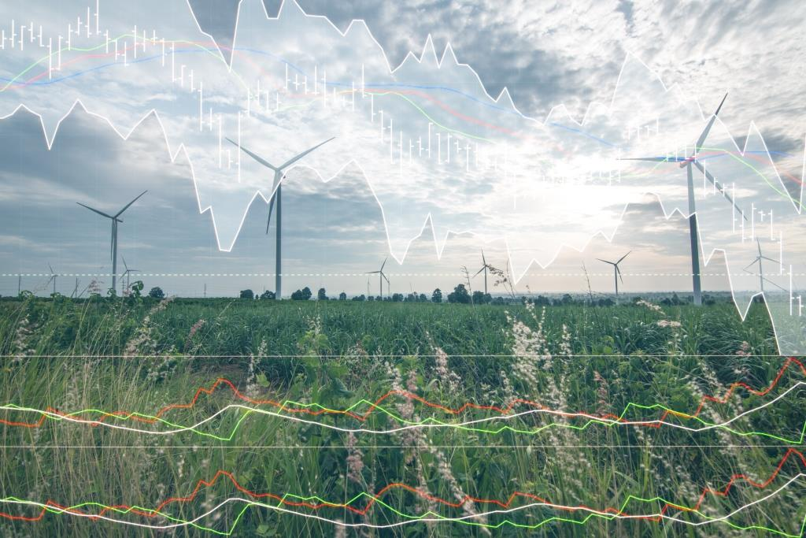
Trading electricity in EU
At the following slide, we consider trading of electrical energy for one, given Hour of Operation.

Slide 8
Time line for trading electrical energy in EU
Day of Operation:
The day where the electrical energy is produced and consumed.
Hour of Operation:
The hour where the electrical energy is produced and consumed.
Long-term contracts (physical and financial):
Some days ahead, week-ahead, month-ahead, year(s) ahead
Day-ahead trading
Intra-day trading
Trading balancing
energy with TSO
Planning phase
D - 1
Day of Operation (D)
Time
Noon D-1:
gate closure
time for spot
trading
Example of
Hour of
Operation
Midnight
Midnight
Midnight

Slide 9

Reliable prices for electricity
At every point in time, a reliable price means
The price contains all available price-relevant information
For the area in question.
New flexibility platforms will be helpful
As they can help adjust the prices
when new information emerges.
For example, information not available when the spot
prices were set
New weather forecasts, unplanned outages, etc.
However, flexibility platforms should not be used to fix
dysfunctional day-ahead and intra-day trading systems.
Instead of this sticking-plaster approach, we must reform
the day-ahead and intra-day trading systems
Fitting them to the new electricity business.
More information on reliable spot prices: see the
PowerPoint presentation Europe’s electricity markets.

Slide 10




Consequences of the new electricity business
For the new electricity business, the value of
electricity can vary greatly within short distances.
Therefore, the new system needs local prices.
For example, local prices can be used for smart grid
technologies
Providing flexibility where and when
it is needed.
Batteries
Local day-ahead prices can be used to decide the next day’s
location of movable battery storage, for example.
The current spot prices and intra-day prices are increasingly
becoming irrelevant
As they do not reflect the value of electricity
Because they do not reflect the local variations
in the value of electricity.

Slide 11


The new electricity business
Plus unreformed trading systems
If the spot and intra-day trading systems are not reformed:
We’ll need flexibility platforms to ensure, producers and consumers of electricity do not react to the signals from the spot prices and intra-day prices
  As this could play havoc with the electricity system.
In this case, the spot and intra-day prices do not have much socio-economic value
They are reduced to toys for traders.

Slide 12
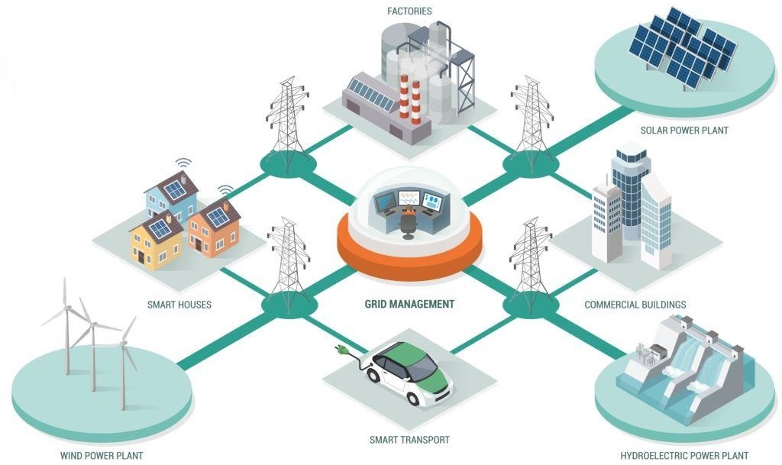
Congestion management during the planning phase – 1
Electrical energy
During the planning phase, there’s no need for elaborate,
manual congestion management, if the trading systems
reflect the grid geography
Meaning: the day-ahead and the
intra-day trading systems must
take the actual grid bottlenecks
into account.
Otherwise, neither system
can produce reliable prices.
For trading systems adapted to the green society:
The congestion management will be done automatically
by the capacity modules of the day-ahead
trading system and the intra-day trading system,
respectively.
With the actual grid bottlenecks taken into account
by both systems.

Slide 13

Congestion management during the planning phase – 2
Electrical energy
With this approach, for the intra-day trading, the new flexibility platforms become competitors to the current operators of the intra-day trading platform XBid.
As they will offer market players an additional entrance to XBid
  More information on intra-day trading: see the PowerPoint presentation Intra-day trading for The Single Electricity Market.
  Further, the flexibility platforms may be used by the TSOs for the trading of balancing energy
    And perhaps balancing capacity, too.

Slide 14
Nodal pricing versus zonal pricing

Slide 15

Nodal or zonal pricing? – 1
Zonal pricing and nodal pricing is explained in the
appendix.
  As can be seen in the appendix: with nodal pricing, you
  split the coupled region into many, very small bidding
  zones (so-called ”nodes”).
Once every day, you run the calculation.
The calculation decides the geographical
areas having the same day-ahead prices
  Thereby, the decision on which areas will have the
  same day-ahead prices is left to the market.
  In contrast: with the zonal system’s relatively large,
  pre-set zones, you may argue the zonal system is
  planned economy.
  For other commodities, we do not have rules dictating
  the commodity must have the same whole-sale price
  for given geographical areas.

Slide 16
Redispatching inside a zone with sub-areas A and B
Example for one hour of tomorrow
For simplicity, exchange of energy with other zones is ignored
A
At price 50 €/MWh, the producers in A have a planned
production 2000 MWh bigger than A’s consumption
Redispatching in A: TSO must sell 500 MWh to players in A
– thereby reducing the energy surplus with 500 MWh.
The TSO’s sale price is 48 €/MWh.
Planned energy
flow: 2000 MW
Grid capacity: 1500 MW
Redispatching in B: TSO must buy 500 MWh from players in B
– thereby reducing the energy deficit with 500 MWh.
The TSO’s purchase price is 53 €/MWh.
At price 50 €/MWh, the producers in B have a planned
production 2000 MWh smaller than B’s consumption
B
Zone’s spot price: 50 €/MWh
The TSO’s redispatching costs (buying at 53, selling at 48):
(53 - 48) €/MWh * 500 MWh = 2500 €
The true day-ahead prices in A and B are 48 and 53 €/MWh

Slide 17
Nodal or zonal pricing? – 2
Because the zonal system typically has large bidding zones,
the TSOs often must pay for redispatching inside a zone
  As the zone’s common spot price often creates a
  planned production surplus in one part of the zone
  and a planned production deficit in another part of the zone.
    And the grid cannot transport the energy between the two parts of the zone.
However, when this happens, the zone’s spot price is unreliable
  The redispatching prices are the true market prices.
The zonal system’s large zones simplifies price hedging
  And price hedging is important for retailers, who have
  customers preferring fixed price contracts.
However, via the grid fees everybody pay for the redispatching
  Therefore, the zonal system forces consumers,
  who prefer spot price contracts, to subsidize
  consumers, who prefer fixed price contracts
€
    As the fixed price consumers do not
    themselves pay the full cost of the hedging.
    Similar, when intra-day trading ignores grid bottlenecks.

Slide 18
Nodal pricing: the commercial players’ settlement of imbalances with the TSO
At the outset, we’d have to establish an imbalance
settlement per node
  However, this would place a big burden on the retailers.
    As they would have to produce a consumption
    forecast for their customers at each node
      Thereby, it would also create a huge
      entrance barrier for new retailers.
Hence, we’ll have to make a settlement for a larger area
  Using an average of the area’s nodal prices as the
  starting point for the settlement.
  This could give wrong incentives, if players can foresee,
  this will give imbalance prices better than the nodal
  prices for given nodes
€
    However you can deal with this by installing
    systems ensuring imbalances are never
    economic advantageous.
    For a greener society, a shift to a one-price system
    for imbalances may not be wise…

Slide 19
Nodal pricing: price hedging
Electricity derivatives – hedging with financial contracts
You’ll never get liquidity in financial contracts using the day-ahead price at a single node as the underlying reference.
Hence, as the underlying reference for financial contracts:
  You must use the average of the nodal prices for larger areas.
Thereby, those who prefer fixed price contracts, will themselves:
  Either bear the remaining risk that their nodal price deviates from the average price.
  Or pay for having this risk removed also.
    With the zonal system, all grid users pay for this risk (via payment for redispatching)
      Even consumers who have spot contracts.
More information on price hedging and electricity derivatives: see the PowerPoint presentations
  Financial prices and spot prices – annual contracts 2002-2017.
  Financial prices and spot prices – quarter contracts 2006-2017.
€

Slide 20
Combination of nodal and zonal pricing
Assume we adapt a version of nodal pricing, where the price for each node is set by double auction
  Hence, we do not use the original nodal system’s shadow price principle.
  Instead, we use the same calculation principle as for the standard zonal pricing
    In this case, the difference between the two systems virtually disappears
      The remaining difference is the size of the zones
        Where the ”adapted nodal pricing” has very small zones and the standard zonal pricing has large zones.
With this ”adapted nodal pricing”, the two systems can co-exist in the same market coupling
  As some countries in the coupled region will need the ”adapted nodal pricing” (i.e. very small zones), whereas other countries can do with the standard zonal pricing (i.e. larger zones).

Slide 21
Appendix 1 Concepts and units
Energy consumed
during an hour:
60 W * 1h = 60 Wh
60 W
Concept
Explanation
Unit
Water analogy
Flow: how much
energy per
second?
Flow: how much
water is passing
by per second?
W
(Watt)
Power
The amount
(for example,
during an hour)
The amount
(for example,
during an hour)
Wh
(Watt-hour)
Energy
The ability to
change a flow
W
(Watt)
The ability to
change a flow
Capacity

Slide 22
Appendix 2 Settlement of imbalances
Settlement of imbalances is the glue between
  The physical world, where electricity is
  produced and consumed.
  The financial system, where electricity is traded.
In EU, the TSOs are responsible for the imbalance settlement.
Example: consider an owner of a wind farm and a given Hour of Operation. For this hour, assume the owner has sold 100 MWh to the market.
  Assume the windfarm actually produces 110 MWh.
  In this case, the TSO buys the extra 10 MWh.
  In a two-price system: if the surplus production was helpful for the electricity system, the TSO pays the market price for the extra 10 MWh
    Hence, compared with the market price, no reward for the surplus production, even if the electricity system needed extra energy during this hour.
  If the surplus production was harmful for the electricity system, the TSO pays a price lower than the market price.
  In a one-price system: if the surplus production was helpful for the electricity system, the TSO pays a price higher than the market price.
    Hence, a reward for helping the system, although the TSO did not ask this player for assistance.
  If the surplus production was harmful for the electricity system, the TSO pays a price lower than the market price.
Similar for a retailer, who buys an amount of energy, which does not correspond to the consumption of the retailer’s customers.
For more information: see the PowerPoint presentation Capacity markets and the Single European Electricity Market and the PDF document The Liberalized Electricity Market.
Production
and
consumption
Imbalance
settlement
Trading:
buy and sell
energy

Slide 23
Appendix 3
Terminology and acronyms

Slide 24
Terminology and acronyms – 1
As used in this presentation
Bidding zone A geographical area, within which the players can trade electricity day-ahead without considering grid bottlenecks.
Border Means a border between two bidding zones.
  Hence, it need not be a border between two countries. It may be a border between two bidding zones inside a country.
Coupled region A geographical area, in which you have a common IT system calculating the area’s spot prices and day-ahead plans for the cross-border energy flows by using:
  The market players’ spot bids.
  Information on the day-ahead cross-border trading capacities.
Double auction A calculation method whereby an exchange’s price is set by using the exchange’s supply curve and the exchange’s demand curve. See the PowerPoint presentation “Maximizing the economic value of market coupling and spot trading” and the PDF document “The Liberalized Electricity Market”.
Electricity Short for electrical energy.
Fixed price contract See spot contract.
Flexibility In this document, this means the ability to change production or consumption of electricity with short notice.
Flow Short for energy flow.

Slide 25
Terminology and acronyms – 2
As used in this presentation
Flow-based zonal market coupling A version of zonal market coupling, where the market coupling calculation includes a simplified load flow calculation. Thereby, the calculation tries to take into account the complicated flows of a meshed grid.
Hour of Operation The hour where the electricity is produced and consumed.
Implicit auction The common term for market coupling and market splitting.
Market coupling A day-ahead congestion management system, you can have on a border, where two electricity exchanges meet. The day-ahead plans for the cross-border energy flows are calculated using the market players’ spot bids and information on the day-ahead cross-border trading capacity. See the PowerPoint presentation “Maximizing the economic value of market coupling and spot trading” and the PDF document “The Liberalized Electricity Market”.
For simplicity, in this presentation, the term market coupling is used for both market coupling and market splitting.
Market splitting A day-ahead congestion management system, you can have on a border, where you have the same electricity exchange on both sides of the border. The day-ahead plans for the cross-border energy flows are calculated using the market players’ spot bids and information on the day-ahead cross-border trading capacity. See the PowerPoint presentation “Maximizing the economic value of market coupling and spot trading” and the PDF document “The Liberalized Electricity Market”.
For simplicity, in this presentation, the term market coupling is used for both market coupling and market splitting.

Slide 26
Terminology and acronyms – 3
As used in this presentation
Nodal pricing With this system, the coupled region is divided into
very small sub-areas called “nodes”
For example, a node may be the sub-area supplied by a
given distribution grid.
A node’s whole-sale price is set by calculating the cost of
supplying a small extra volume of electrical energy to the node
Example for a given hour – if a node’s demand is 1000 MWh:
the node’s price is set by calculating the cost of supplying
one extra kWh (thereby increasing the node’s supply
to 1000.001 MWh). Hence, the nodal price is a shadow price.
In the nodal calculation, the complexities of energy flows in a
meshed grid is taken into account. Thereby, nodal pricing is an
alternative to flow-based zonal market coupling.
Apart from the nodal system’s shadow price principle, you may
say nodal pricing deviates from zonal pricing in this way:
By splitting the coupled region into very small sub-areas, the nodal
pricing abandons large, (politically set?) bidding zones.

Slide 27
Terminology and acronyms – 4
As used in this presentation
Prosumer A player who is both a producer and a consumer of a commodity.
SIDC See XBid.
Spot bid A purchase bid or a sales offer submitted to a spot exchange.
Spot contract A consumer having this contract with a retailer, pays the retailer the spot price plus the retailer’s mark-up. Hence, the consumer’s price is tracking the spot price.
The consumer’s price can track the hourly spot price, if the consumer has a meter measuring the consumption per hour.
This contrasts with a fixed price contract, where the consumer has a fixed electricity price for a long period (a year, for example). In practice, with a fixed price contract, the consumer’s price is tracking the market’s forecast of the whole-sale price, as the price is fixed before the delivery period.
Spot exchange In this document, a spot exchange is an electricity exchange where
  Electrical energy is traded day-ahead.
  The exchange’s day-ahead prices are calculated by means of double auction.
  See the PowerPoint presentation “Maximizing the economic value of market coupling and spot trading” and the PDF document “The Liberalized Electricity Market”.
Spot price A day-ahead price used by a spot exchange (or the spot exchange’s associated clearing house) to settle the participants’ trading at the exchange.
The spot price is calculated using double auction.
See the PowerPoint presentation “Maximizing the economic value of market coupling and spot trading” and the PDF document “The Liberalized Electricity Market”.

Slide 28
Terminology and acronyms – 5
As used in this presentation
TSO Transmission System Operator.
In EU, each TSO has two tasks:
  Operate the high-voltage grid (the transmission grid) in the TSO’s so-called control area.
  Be responsible for the security of supply in the TSO’s control area.
Most EU Member States have only one TSO. Hence, the TSO’s control area is the whole country.
However, some Member States have more than one TSO (e.g. Germany).
XBid A European intra-day trading platform. As of 19 November 2019, the name is SIDC (Single Intra-Day Coupling).
Zonal market coupling A market coupling, where the coupled region is divided into relatively large bidding zones.
  Further, for each zone, the zone’s day-ahead exchange prices are calculated by means of double auction (i.e. it’s spot prices).
Zone Short for bidding zone.

Slide 29

Thank you for your attention!
Anders Plejdrup Houmøller
Houmoller Consulting ApS
Tel. +45 28 11 23 00
anders@houmollerconsulting.dk
Web houmollerconsulting.dk

