Slide 1
Introduction
Anders Plejdrup Houmøller
CEO, Houmoller Consulting ApS
In the appendix, you’ll find a list of the terms and acronyms used in this presentation.
Concerning other documents referred to in this presentation:
  At houmollerconsulting.dk, you can download the documents from the sub-page Facts and findings.
This PowerPoint presentation is animated
  It’s strongly recommended to run the animation when viewing the presentation.
On most computers, you can start the animation by pressing F5.
  Now the presentation moves one step forward, when you press Page Down. It moves one step backward, when you press Page Up.

Slide 2
Agenda for this presentation on market coupling
Four topics:
  Transparency.
  Zonal pricing versus nodal pricing.
  Quality of market coupling.
  Unbundling.

Slide 3
Transparency for market coupling
Eventually, no end user, producer, trader or TSO
can opt out of the market coupling
  “You can check out any time you like – but you can never leave”
The Eagles: Hotel California.
Unfortunately, the legal limbo for market coupling
creates a transparency limbo also.
For market coupling: it seems as if we have to fight
for every thing, we want to have information on.
Solution: create a Confidentiality List of things, which
cannot be public
  Example: individual players’ exchange bids are confidential.
Per definition, everything not on the
Confidentiality List is public.
Subject the list to public consultation.

Slide 4
Nodal pricing versus zonal pricing

Slide 5
Nodal or zonal pricing? – 1
Zonal pricing and nodal pricing is explained in the
appendix.
  As can be seen in the appendix: with nodal pricing, you
  split the coupled region into many, very small price zones
  (so-called ”nodes”).
Once every day, you run the calculation.
The calculation decides the geographical
areas having the same day-ahead prices
  Thereby, the decision on which areas will have the
  same day-ahead prices is left to the market.
  In contrast: with the zonal system’s relatively large,
  preset zones, you may argue the zonal system is a
  version of planned economy.

Slide 6
Nodal or zonal pricing? – 2
Because the zonal system has relatively large price zones,
the TSOs often have to pay for redispatching inside a zone
  As the zone’s common spot price often creates a huge,
  planned production surplus in part A of the zone and a
  huge, planned production deficit in part B of the zone
    And the zone’s grid cannot transport
    the surplus energy from A to B.
However, when this happens, the zone’s spot price is unreliable
  The redispatching prices are the true
  day-ahead prices for A and B, respectively.
The zonal system’s relatively large zones simplifies price hedging
  And price hedging is important for retailers, who have
  customers preferring fixed price contracts.
However, via the grid fees everybody pay for the redispatching
  Therefore, you may argue the zonal system makes end
  users, who prefer spot price contracts, cross-subsidizing
  end users, who prefer fixed price contracts
    As the fixed-price end users do not
    themselves pay the full cost of the hedging.
€

Slide 7
Redispatching inside a zone with sub-areas A and B
Example for one hour of tomorrow
For simplicity, exchange of energy with other zones is ignored
A
At price 50 €/MWh, the producers in A have a planned
production 2000 MWh bigger than A’s consumption
Redispatching in A: TSO must sell 500 MWh to producers in A
– thereby reducing their planned production with 500 MWh.
The TSO’s sale price is 48 €/MWh.
Planned market
coupling flow: 2000 MW
Grid capacity: 1500 MW
Redispatching in B: TSO must buy 500 MWh from producers in B
– thereby increasing their planned production with 500 MWh.
The TSO’s purchase price is 53 €/MWh.
At price 50 €/MWh, the producers in B have a planned
production 2000 MWh smaller than B’s consumption
B
Zone’s spot price: 50 €/MWh
The TSO’s redispatching costs (buying at 53, selling at 48):
(53 - 48) €/MWh * 500 MWh = 2500 €
The true day-ahead prices in A and B are 48 and 53 €/MWh

Slide 8
Nodal pricing: the commercial players’ settlement of imbalances with the TSO
At the outset, we’d have to establish an imbalance
settlement per node
  However, this would place a big burden on the retailers.
    As they would have to produce a consumption
    forecast for their customers at each node
      Thereby, it would also create a huge
      entrance barrier for new retailers.
Hence, we’ll have to make a settlement for a larger area
  Using an average of the area’s nodal prices as the
  starting point for the settlement.
  This could give wrong incentives, if players can foresee,
  this will give imbalance prices better than the nodal
  prices for given nodes
€
    However you can deal with this by installing
    systems ensuring imbalances are never
    economic advantageous.

Slide 9
Nodal pricing: price hedging
Derivatives – hedging with financial contracts
You’ll never get liquidity in financial contracts using the day-ahead price at a single node as the underlying reference.
Hence, as the underlying reference for financial contracts:
  You must use the average of the nodal prices for larger areas, which have strong interconnectors.
Thereby, those who prefer fixed-price contracts, will themselves:
  Either bear the remaining risk that their nodal price deviates from the average price.
  Or pay for having this risk removed also.
    With the zonal system, all grid users pay for this risk (via payment for redispatching)
      Even end users who have spot contracts.
€

Slide 10
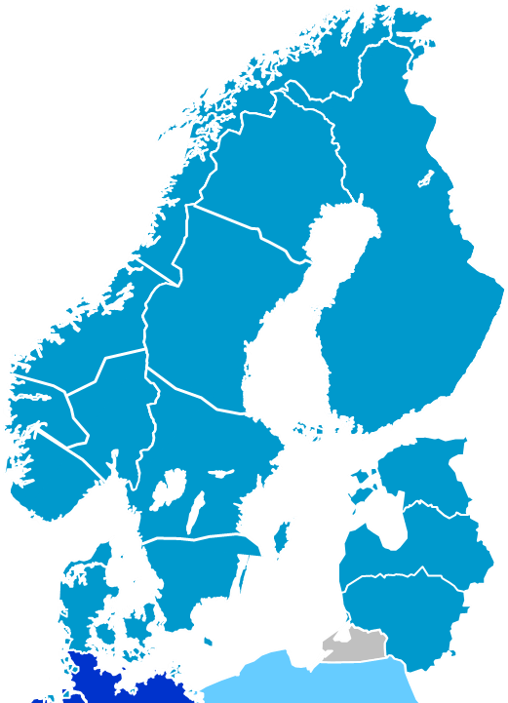
Nodal or zonal pricing? – 3
In Scandinavia, Denmark has 2 price zones, Sweden has 4 price zones and Norway has currently 5 price zones.
With this many zones, the Scandinavian zonal pricing is not very different from nodal pricing
  This is especially true for Norway, where the TSO can change the zones with relatively short notice.
NO4
SE1
SE2
NO3
NO5
NO1
^{*)}
NO2
SE3
SE4
DK1
DK2
^{*)} In this description, we ignore the nodal system’s shadow price principle.

Slide 11
Combination of nodal and zonal pricing
Assume we adapt a version of nodal pricing, where the price for each node is set by double auction
  i.e. same calculation principle as for the standard zonal pricing
    In this case, the difference between the two systems virtually disappears
      The remaining difference is the size of the zones
        Where the ”adapted nodal pricing” has very small zones and the standard zonal pricing has relatively large zones.
With this ”adapted nodal pricing”, the two systems can co-exist in the same market coupling
  As some countries in the coupled area may prefer the ”adapted nodal pricing” (i.e. very small zones), whereas other countries may prefer the standard zonal pricing (i.e. relatively large zones).

Slide 12
Quality of market coupling

Slide 13
Inclusive or predatory?
The issue of market coupling governance
I
I
I
I
I
I
In order to have prosperity for all, we
need to have “inclusive economies”
  Distributing power widely, establishing
  the rule of law and free-market systems.
I: Influence
Even in the rich democracies, ruthless lobbying
from vested interests may strangle
economic growth by preventing us from
having truly inclusive economies.
^{*)}
To establish the Single Electricity Market we need to
install an inclusive governance for the market coupling
  Securing fair and formalised influence for nations,
  end users, producers, TSOs and market players.
^{*)} For example, refer to the newspaper The Economist’s
comments 14 April 2012 to the book
Why Nations Fail: The Origins of Power, Prosperity, and Poverty.

Slide 14
Ignorance is expensive!
Also in market coupling
In the market coupling calculations, we need
to apply the so-called ”welfare criterion”
^{*)} You may refer to the PowerPoint
presentation Welfare criterion
  Thereby, the calculations will produce
  economic optimal prices and energy flows.
^{*)}
However, at the spot exchanges, we have seen employees
fighting desperately against the welfare criterion
  Hence verifying they understand neither
  linear optimization nor economics
    Perhaps not people, we should entrust
    our linear optimization…
  This lack of understanding is daily inflicting an economic
  loss on market players and societies – via the current
  wrong handling of block bids and interconnector capacity.
^{**)}
    The wrong handling of block bids and capacity was
    not requested by consumers
However, the purpose of The Single Electricity Market
is to make Europe’s trade & industry competitive!
Thereby helping to get Europe out of the current crisis.
As always, by having good governance, the stakeholders can
themselves make decisions concerning their own money.
^{**)} Please refer to the PowerPoint presentation Market coupling – technical issues

Slide 15

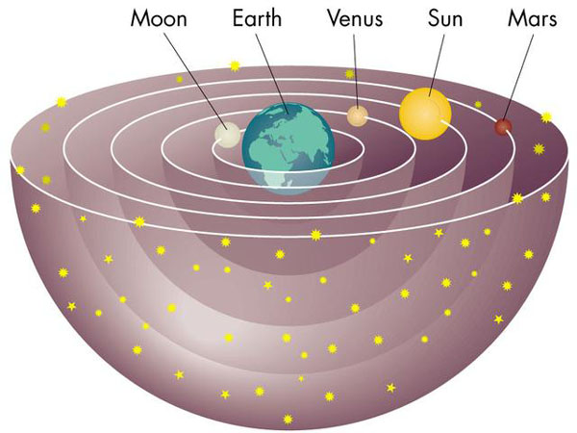



Use economic efficient market coupling
Not intuitive ”solutions”
On technical issues, our intuition is normally wrong.
The earth is not flat.
The sun does not rotate around the earth.
What force is acting
on the turning biker?
Actual
force
Intuitive
”centrifugal force”
Try quantum mechanics and relativity
theory – profoundly defying intuition!
Ʃ Δq_{h}δ_{h} = Ʃ τ_{c,t}
Ʃ q_{b,t}β_{b} = Ʃ β_{c}
For our ancestors, intuition was not
designed to cope with such issues.
Ʃ φ
In a modern world, applying stone age reasoning
to technical problems is very expensive!

Slide 16
Unbundling

Slide 17
Unbundling – 1
Unfortunately, the spot exchanges become monopolies when market coupling or market splitting is introduced as the day-ahead congestion management system
  Please refer to the PowerPoint presentation Market coupling makes real competition betw. spot exchanges unfeasible.
Hence, in order to avoid cross-subsiding, the spot exchanges must unbundle
  Unbundling means an organisation having a monopoly task cannot have any other business
    Hence, cross-subsidising is automatically prevented
      The regulators can focus on controlling the organisation’s economical efficiency
        Please refer to the PDF document Unbundling of spot exchanges and associated clearing houses.

Slide 18
Unbundling – 2
Terminating cross-subsidizing
Note: this also means the spot exchanges cannot be involved in intra-day trading
  As experience shows: this gives heavy cross-subsiding – with the many spot players subsidizing the fewer intra-day players.
As cases – turn-over for the year 2013 (numbers in TWh):
  EPEX Spot (Austria, France, Germany, Switzerland)
    Spot turnover 323
    Intra-day turnover 23
  Nord Pool Spot
    Spot turnover (Baltic-Nordic area) 349
    Intra-day turnover (Baltic-Nordic, Germany) 4
  APX (Belgium, the Netherlands)
    Spot turnover 64
    Intra-day turnover 1
  As can be seen: the turnover at the intra-day markets is paltry. It cannot finance the intra-day trading platforms
    Hence the intra-day trading platforms only survive due to heavy cross-subsidizing from the spot trading.

Slide 19
Unbundling – 3
Terminating the spot market players
subsidizing the intra-day trading platforms
Adding insult to injury: as a
consequence of the
cross-subsidizing, small
market players are
subsidizing big players
First and foremost, the intra-day
market is important for big players
Who face the risk of big, unplanned outages.

Slide 20
Appendix
Terminology and acronyms

Slide 21
Terminology and acronyms – 1
As used in this presentation
AC Alternating Current.
Border means a border between two price zones.
  Hence, it need not be a border between two countries. It may be a border between two price zones inside a country.
Coupled region A geographical area, in which you have a common IT system calculating the area’s flows and day-ahead prices by using: the market players’ day-ahead exchange bids and information on the day-ahead cross-border trading capacities.
Double auction A calculation method whereby an exchange’s price is set by using the exchange’s supply curve and the exchange’s demand curve. See the PowerPoint presentation “Maximizing the economic value of market coupling and spot trading”.
Energy flow Actually, in this presentation, “energy flow” means “day-ahead plans for cross-border energy flow”.
Note that implicit auction does not create energy flows. It merely creates day-ahead plans for the cross-border energy flows. Later, these plans my be modified by market players’ intra-day, cross-border trading and/or the TSOs’ cross-border trading of regulating energy.

Slide 22
Terminology and acronyms – 2
As used in this presentation
Flow Short-term for energy flow.
Flow-based zonal market coupling A version of zonal market coupling, where the market coupling calculation includes a simplified load flow calculation. Thereby, the calculation tries to take into account the complicated flows of a meshed AC grid.
Implicit auction The common term for market coupling and market splitting.
Market coupling A day-ahead congestion management system, you can have on a border, where two electricity exchanges meet. The day-ahead plans for the cross-border energy flows are calculated using the two exchanges’ bids and information on the day-ahead cross-border trading capacity.
Market splitting A day-ahead congestion management system, you can have on a border, where you have the same electricity exchange on both sides of the border. The day-ahead plans for the cross-border energy flows are calculated using the exchange’s bids and information on the day-ahead cross-border trading capacity.

Slide 23
Terminology and acronyms – 3
As used in this presentation
Nodal pricing With this system, the coupled region is divided into
very small sub-areas called “nodes”.
For example, a node may be the sub-area supplied by a
given distribution grid.
A node’s whole-sale price is set by calculating the cost of
supplying a small extra volume of electrical energy to the node.
Example for a given hour – if a node’s demand is 1000 MWh:
the node’s price is set by calculating the cost of supplying
one extra kWh (thereby increasing the node’s supply
to 1000.001 MWh). Hence, the nodal price is a shadow price.
In the nodal calculation, the complexities of energy flows in a
meshed AC grid is taken into account. Thereby, nodal pricing is an
alternative to flow-based zonal market coupling.
Apart from the nodal system’s shadow price principle, you may
say nodal pricing deviates from zonal pricing in this way:
By splitting the coupled region into very small sub-areas, the nodal
pricing abandons the large, (politically?) preset price zones.

Slide 24
Terminology and acronyms – 4
As used in this presentation
Price zone A geographical area, within which the players can trade electrical energy day-ahead without considering grid bottlenecks.
Spot bid A purchase bid or a sales offer submitted to a spot exchange.
Spot contract A consumer having this contract with a retailer, pays the retailer the exchange day-ahead price plus the retailer’s mark-up. Hence, the consumer’s price is tracking the wholesale market’s daily price.
Spot exchange In this document, a spot exchange is an electricity exchange where
  Electrical energy is traded day-ahead.
  The day-ahead prices are calculated by means of double auction.

Slide 25
Terminology and acronyms – 5
As used in this presentation
Spot price A price calculated by a spot exchange. Either by a calculation performed by the spot exchange itself, or by a calculation performed by a company, to which the calculation has been outsourced.
TSO Transmission System Operator.
Welfare criterion A criterion used in the calculation of the day-ahead exchange prices and the planned energy flows
  The criterion states the preferred solution must be the solution maximizing the economic value of the day-ahead exchange trading. Please refer to the PowerPoint presentation Welfare criterion.
Zonal market coupling A market coupling, where the coupled region is divided into relatively large price zones
  Further, for each zone, the zone’s day-ahead exchange prices are calculated by means of double auction (i.e. it’s spot prices).
Zone Short-term for price zone.

Slide 26

Thank you for your attention!
Anders Plejdrup Houmøller
Houmoller Consulting ApS
Tel. +45 28 11 23 00
anders@houmollerconsulting.dk
Web houmollerconsulting.dk

