Slide 1
Hedging in Denmark and Southern Sweden (SE4)
This document presents data for hedging done by means of cleared Electricity Price Area Differential (EPAD) contracts and Contracts for Difference (CfDs).
In the appendix, you’ll find a list of the terms and acronyms used in this document.
Concerning documents referred to in this presentation:
At houmollerconsulting.dk, you can download the documents from the sub-page Facts and findings.
This PowerPoint presentation is animated
It’s recommended to run the animation when viewing the presentation.
On most computers, you can start the animation by pressing F5.
Now the presentation moves one step forward, when you press Page Down. It moves one step backward, when you press Page Up.

Slide 2
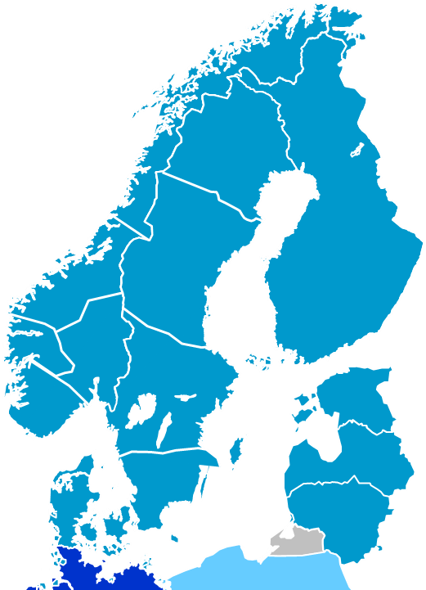
The price zones
SE1
Sweden is split into the four price zones SE1, SE2, SE3 and SE4.
Denmark is split into the two price zones DK1 and DK2.
SE2
SE3
SE4
DK1
DK2

Slide 3
EPADs/CfDs for Southern Sweden (SE4) Hedging for 2014
Source: Nasdaq OMX Commodities
December 23rd, 2013 the Open Interests for the EPADs/CfDs were:
Product MW TWh
SYMALYR-14 267 2.34
SYMALJAN-14 65 0.05
SYMALFEB-14 48 0.03
SYMALMAR-14 20 0.015
SYMALAPR-14 11 0.008
SYMALQ1-14 414 0.89
SYMALQ2-14 284 0.62
SYMALQ3-14 268 0.59
SYMALQ4-14 267 0.59
By summing the TWhs, we get an upper limit for the hedging for the year 2014 done by means of cleared EPADs/CfDs by the end of 2013. The upper limit is 5.14 TWh
In 2013, consumption in SE4 was about 24 TWh.

Slide 4
EPADs/CfDs for Western Denmark Hedging for 2014
Source: Nasdaq OMX Commodities
December 23rd, 2013 the Open Interests for the EPADs/CfDs were:
Product MW TWh
SYARHYR-14 261 2.29
SYARHJAN-14 140 0.10
SYARHFEB-14 60 0.04
SYARHMAR-14 0 0.00
SYARHQ1-14 448 0.97
SYARHQ2-14 302 0.66
SYARHQ3-14 251 0.55
SYARHQ4-14 261 0.58
By summing the TWhs, we get an upper limit for the hedging for the year 2014 done by means of cleared EPADs/CfDs by the end of 2013. The upper limit is 5.19 TWh
In 2012, the net consumption in Western Denmark was 20.0 TWh.

Slide 5
CfDs for Eastern Denmark Hedging for 2014
Source: Nasdaq OMX Commodities
December 23rd, 2013 the Open Interests for the EPADs/CfDs were:
Product MW TWh
SYCHPYR-14 159 1.39
SYCHPJAN-14 74 0.06
SYCHPFEB-14 40 0.03
SYCHPMAR-14 0 0.00
SYCHPQ1-14 230 0.50
SYCHPQ2-14 244 0.53
SYCHPQ3-14 174 0.38
SYCHPQ4-14 159 0.35
By summing the TWhs, we get an upper limit for the hedging for the year 2014 done by means of cleared EPADs/CfDs by the end of 2013. The upper limit is 3.24 TWh
In 2012, the net consumption in Eastern Denmark was 13.4 TWh.

Slide 6
CfDs for Southern Sweden (SE4) Hedging for 2012
Source: Nasdaq OMX Commodities
December 28th, 2011 the Open Interests for the CfDs were:
Product MW TWh
SYMALYR-12 262 2.30
SYMALQ1-12 554 1.21
SYMALJAN-12 109 0.08
SYMALFEB-12 5 0.003
SYMALQ2-12 292 0.64
SYMALQ3-12 258 0.57
SYMALQ4-12 267 0.59
By summing the TWhs, we get an upper limit for the hedging for the year 2012 done by means of cleared CfDs by the end of 2011. This upper limit is
5.39 TWh
In 2012, the consumption in SE4 was about 25 TWh.

Slide 7
CfDs for Western Denmark Hedging for 2012
Source: Nasdaq OMX Commodities
December 28th, 2011 the Open Interests for the CfDs were:
Product MW TWh
SYARHYR-12 396 3.48
SYARHQ1-12 778 1.70
SYARHJAN-12 46 0.03
SYARHFEB-12 16 0.01
SYARHQ2-12 446 0.97
SYARHQ3-12 341 0.75
SYARHQ4-12 396 0.87
By summing the TWhs, we get an upper limit for the hedging for the year 2012 done by means of cleared CfDs by the end of 2011. This upper limit is
7.82 TWh
In 2012, the net consumption in Western Denmark was 20.0 TWh.

Slide 8
CfDs for Eastern Denmark Hedging for 2012
Source: Nasdaq OMX Commodities
December 28th, 2011 the Open Interests for the CfDs were:
Product MW TWh
SYCHPYR-12 115 1.01
SYCHPQ1-12 134 0.29
SYCHPJAN-12 40 0.03
SYCHPFEB-12 20 0.01
SYCHPQ2-12 125 0.27
SYCHPQ3-12 113 0.25
SYCHPQ4-12 120 0.27
By summing the TWhs, we get an upper limit for the hedging for the year 2012 done by means of cleared CfDs by the end of 2011. This upper limit is
2.13 TWh
In 2012, the net consumption in Eastern Denmark was 13.4 TWh.

Slide 9
CfDs for Western Denmark Hedging for 2011
Source: Nasdaq OMX Commodities
December 29th, 2010 the Open Interests for the CfDs were:
Product MW TWh
SYARHYR-11 559 4.90
SYARHQ1-11 1123 2.42
SYARHJAN-11 67 0.05
SYARHFEB-11 59 0.04
SYARHQ2-11 598 1.31
SYARHQ3-11 489 1.08
SYARHQ4-11 544 1.20
By summing the TWhs, we get an upper limit for the hedging for the year 2011 done by means of cleared CfDs by the end of 2010. This upper limit is
11.0 TWh
In 2011, the net consumption in Western Denmark was 20.2 TWh.

Slide 10
CfDs for Eastern Denmark Hedging for 2011
Source: Nasdaq OMX Commodities
December 29th, 2010 the Open Interests for the CfDs were:
Product MW TWh
SYCHPYR-11 206 1.80
SYCHPQ1-11 357 0.77
SYCHPJAN-11 35 0.03
SYCHPFEB-11 30 0.02
SYCHPQ2-11 215 0.47
SYCHPQ3-11 157 0.35
SYCHPQ4-11 206 0.46
By summing the TWhs, we get an upper limit for the hedging for the year 2011 done by means of cleared CfDs by the end of 2010. This upper limit is
3.9 TWh
In 2011, the net consumption in Eastern Denmark was 13.6 TWh.

Slide 11
Appendix
Terminology and acronyms

Slide 12
Terminology and acronyms – 1 As used in this presentation
CfD Contract for Difference. The former name for a financial contract hedging against the risk there is a difference between the System Price and the spot price of a given Baltic-Nordic price zone.
The terminology was changed 30 September 2013: now the name is EPAD contract (Electricity Price Area Differential).
Example: the underlying reference for the EPAD/CfD for DK1 is this difference
Price_{DK1} - (System Price).
DK1 and DK2 The price zones of Western and Eastern Denmark respectively. Please refer to the picture at slide no. 2.
Double auction A calculation method whereby an exchange’s price is set by using the exchange’s supply curve and the exchange’s demand curve. See the PowerPoint presentation “Maximizing the economic value of market coupling and spot trading”.
EPAD contract Electricity Price Area Differential contract. See CfD.
Net consumption The electricity consumption excl. grid losses.
Nordic and Nordic area In this document, this refers to the four countries Denmark, Finland, Norway and Sweden.

Slide 13
Terminology and acronyms – 2 As used in this presentation
Open Interest For a given financial product, this is the net hedging done by means of the product.
A financial product’s turn-over will normally be bigger than the product’s Open Interest, as traders may move in and out of positions in financial contracts.
Note: For a given financial product, the Open Interest only measures the product’s cleared volume (i.e. the volume of contracts where the contracts’ settlements are done by a clearing house).
In addition to this volume, there may be bilateral contracts made between parties who have chosen to do without clearing. For each such contract, the contract’s two parties will themselves take care of the settlement. However, these contracts do not contribute to the market’s transparency: the contracts’ prices and volumes are not public known.
Price zone A geographical area, within which the players can trade electrical energy day-ahead without considering grid bottlenecks.

Slide 14
Terminology and acronyms – 3 As used in this presentation
SE4 The price zone of Southern Sweden. Please refer to the picture at slide no. 2.
Spot bid A purchase bid or a sales offer submitted to a spot exchange.
Spot exchange In this document, a spot exchange is an electricity exchange where
Electrical energy is traded day-ahead.
The day-ahead prices are calculated by means of double auction.
Spot price A price calculated by a spot exchange. Either by a calculation performed by the spot exchange itself, or by a calculation performed by a body, to which the calculation has been outsourced.
System Price A virtual price. It’s the theoretical, common spot price we would have in the Nordic area, if there were no grid bottlenecks in the area covered by the four countries.

Slide 15
Thank you for your attention!
Anders Plejdrup Houmøller
Houmoller Consulting
Tel. +45 28 11 23 00
anders@houmollerconsulting.dk
Web houmollerconsulting.dk

